Slide 1
Design Patterns - Observer
By Monika, Brenton, Linkun, Parham

Slide 2
Design Pattern #4 out of 5: Observer
It is a one to many dependence between objects
If one object changes state all of its dependents are notified and updated automatically
For example for the users who are followers on Instagram they automatically get updates on the Instagram account they follow. All followers are observers.
Every time a new post has been added to the Instagram account the Instagram account sends out a notification to the followers.
The individuals who follow the Instagram account can also unfollow them to prevent updates.
SocialMedia will acts as a the NewPost. Follower will act as a the Observer.
Problem: Whenever a constructor is called an object reference is returned and a new object gets created in memory
Solution: make the constructor private(therefore uncallable outside the class)
New Problem: now ZERO objects can be constructed outside of that class
Second Solution: make a static method which acts like a “substitute constructor” but which creates a new object (by calling the private constructor) if and only if there is no existing object; otherwise it simply returns a reference to the already-existing object.

Slide 3
Observer Pattern: 4 Parts
1. Subject
An interface or Abstract Class
Defines the method(s) to add or remove Observer objects
2.Concrete Subject
concrete subject class
Implements Subject
When a change occurs, it will notify the attached Observer
3. Observer
An interface or Abstract Class
Provides a way for objects to be notified of changes made in the subject
4. Concrete Observer
Concrete class
Implements Observers to receive notifications from subject
The observer pattern allows one object to send notification to an open-ended number of other objects

Slide 4
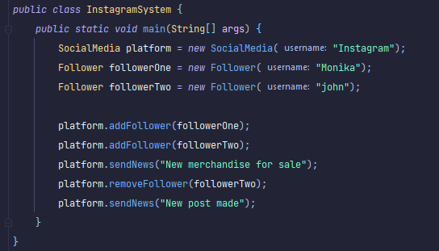
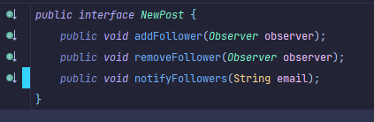
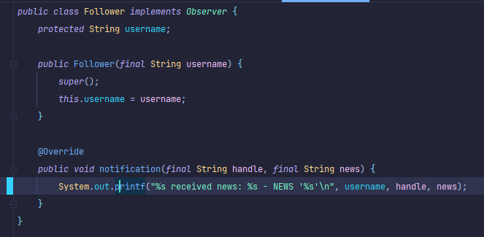

Observer in Action
Notes:
public class Follower implements Observer { protected String username; public Follower(final String username) { super(); this.username = username; } @Override public void notification(final String handle, final String news) { System.out.printf("%s received news: %s - NEWS '%s'\n", username, handle, news); } }
public class InstagramSystem { public static void main(String[] args) { SocialMedia platform = new SocialMedia("Instagram"); Follower followerOne = new Follower("Monika"); Follower followerTwo = new Follower("john"); platform.addFollower(followerOne); platform.addFollower(followerTwo); platform.sendNews("New merchandise for sale"); platform.removeFollower(followerTwo); platform.sendNews("New post made"); } }
public interface NewPost { public void addFollower(Observer observer); public void removeFollower(Observer observer); public void notifyFollowers(String email); }
public interface Observer { public void notification(String handle, String news); }

Slide 5
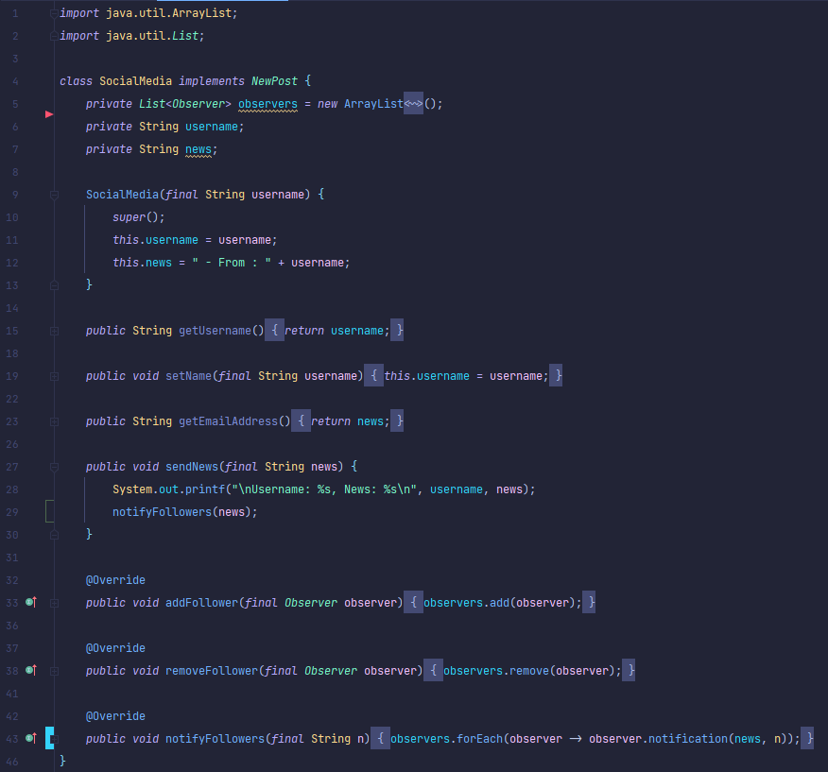
Observer in Action
Notes:
import java.util.ArrayList; import java.util.List; class SocialMedia implements NewPost { private List<Observer> observers = new ArrayList<Observer>(); private String username; private String news; SocialMedia(final String username) { super(); this.username = username; this.news = " - From : " + username; } public String getUsername() { return username; } public void setName(final String username) { this.username = username; } public String getEmailAddress() { return news; } public void sendNews(final String news) { System.out.printf("\nUsername: %s, News: %s\n", username, news); notifyFollowers(news); } @Override public void addFollower(final Observer observer) { observers.add(observer); } @Override public void removeFollower(final Observer observer) { observers.remove(observer); } @Override public void notifyFollowers(final String n) { observers.forEach(observer -> observer.notification(news, n)); } }

Slide 6
Observer Lab and Quiz
Lab:
Use a Observer Design Pattern to create a class called Instagram
No matter how many requests are made to create a Instagram Object, only a single instance (maximum will ever exist)
Quiz:
Why would we use a Observer design pattern? Give a real-life example. Instagram, followers, unfollowers, and email notifications
What are the important ingredients to implement a Observer? Private constructor, non-private static substitute constructor which returns a reference to a static variable. The substitute constructor will call the private constructor if no object yet exists.

